Slide 1

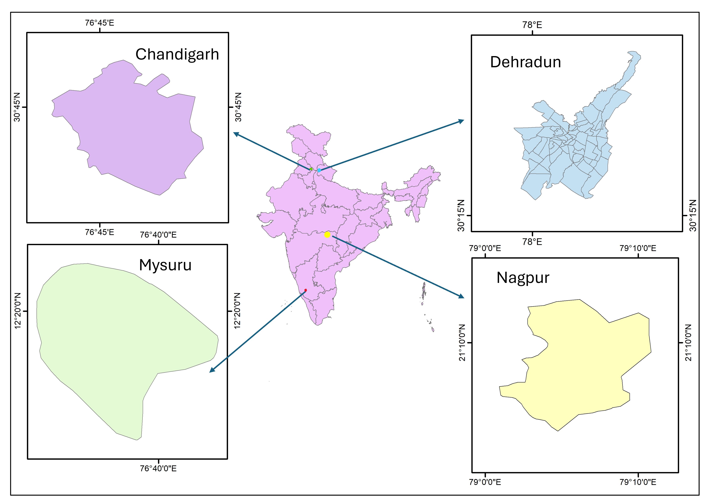
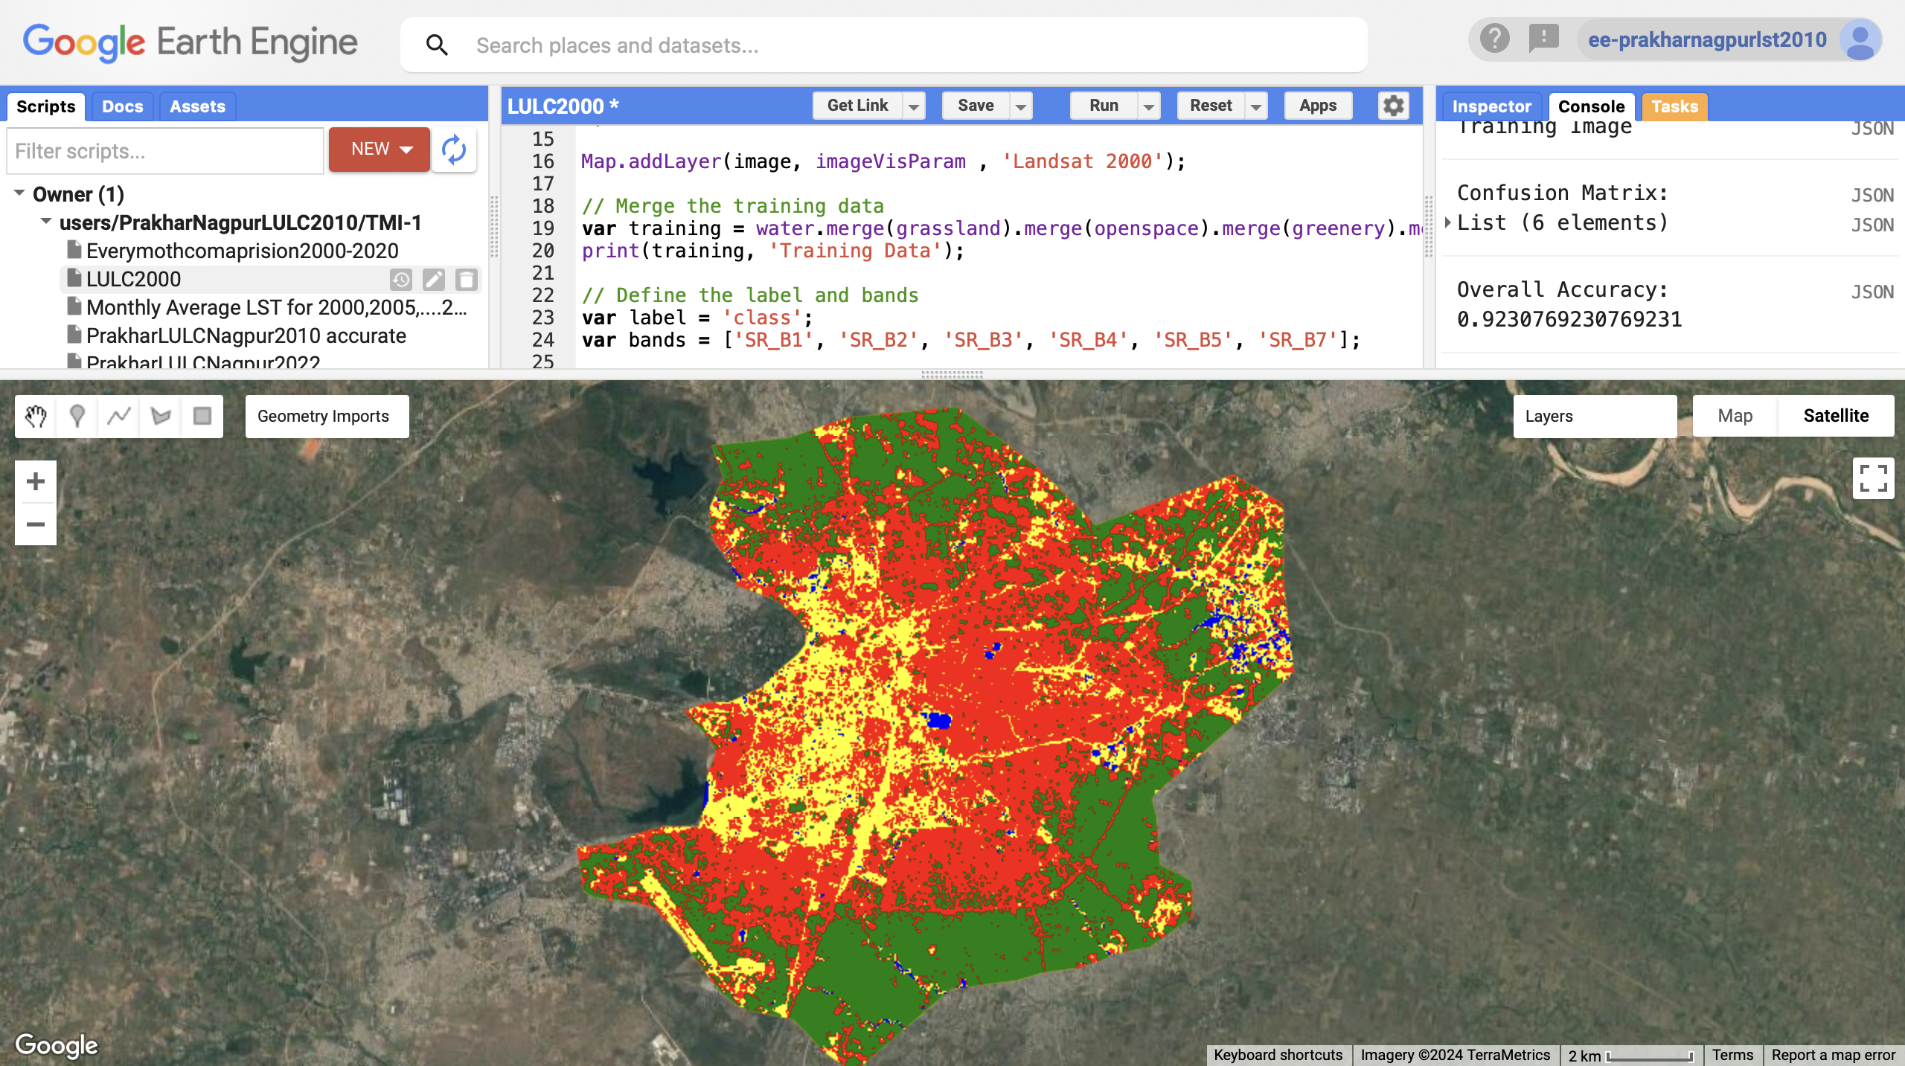
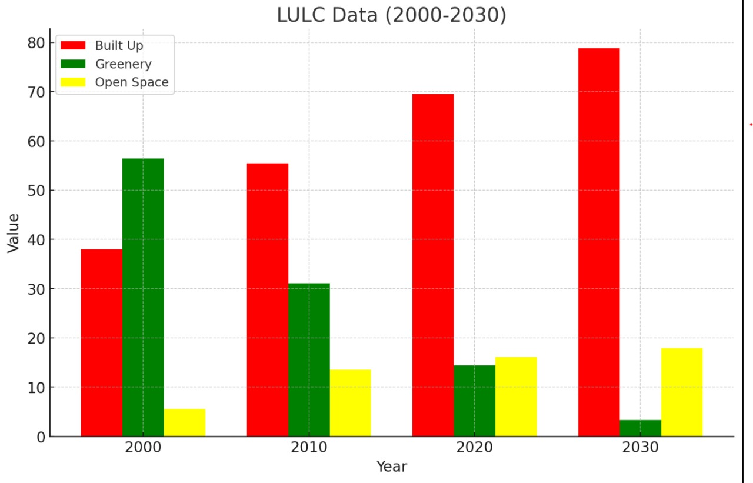
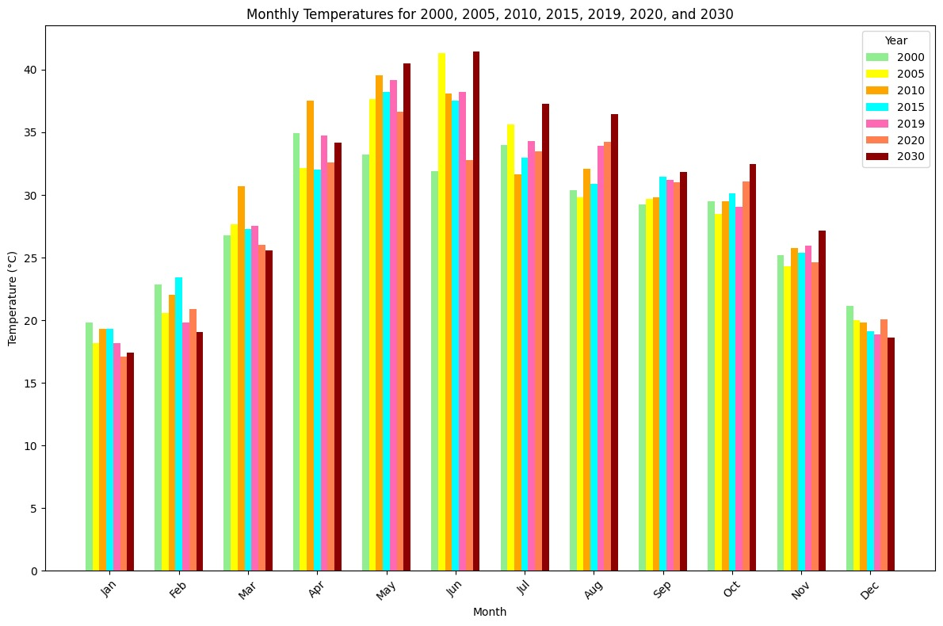
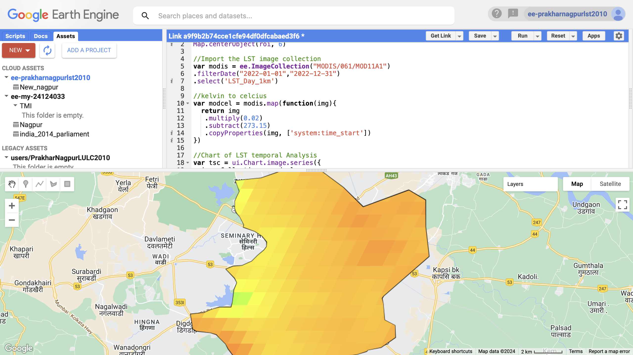
Urban Heat Island Impact Assessment
Presentation Group
Daksh Gogna , Mona Jat , Prakhar Agrawal, Shivansh Singh
Faculty Supervisor Name: Ajanta Goswami
UG TA Name: Akshay Panwar
Problem Statement
Prototype/Experiment Details
The urban heat island refers to the localized increase in temperature within urban areas compared to their rural surroundings ,primarily due to human activities and changes in land cover.
This assessment involves the quantification of temperature variation within urban landscape.
This study seeks to evaluate the magnitude and spatial distribution of UHI in a selected urban area, analyze its correlation with factors such as land use , vegetation cover, and infrastructure type.
Through this analysis, the goal is to inform urban planning strategies that mitigate UHI effects and enhance the livability and sustainability of urban environments.
Main Goal is to provide crucial statistical trends to urban planning authorities to help minimize uhi effects.
LULC:
We used the Random Forest algorithm(which is a machine learning technique) to perform the Land Cover Classification on Google Earth Engine .The javascript loaded Landsat images within a specified date range and filters for images with less than 5% cloud cover. The images are then clipped to the region of interest (ROI).By providing training datasets to different classes(Water, Forest, Builtup and Openspace), we obtained the LULC for the city. We also plotted a pie-chart depicting the percentage area covered by different landcover types. Using the csv values from this pie-chart, we then predicted the percentage area cover of each Landcover types for the year 2030.
.
LST:
We again used Javascript on Google Earth Engine to import MODIS collection for daily LST data for a given time range. We then computed the mean LST image, clipped it to the ROI, and displayed it with specified visualisation parameters.
We then plotted graphs on GEE showing the average LST for each month for a fixed year. We did this for every year from 2000-2020. We then downloaded the csv data from the graphs obtained and then by using GoogleColab, we plotted the graph showing the comparison of how the average LST is changing every year for a fixed month.Using this data we plotted how the temperatures are changing in winter and summer season and projected what the temperature will be in 2028 and 2030 using regression
Project Scope: Analyzed Urban Heat Island (UHI) effects across four Indian cities— Chandigarh, Dehradun, Nagpur, and Mysuru—to capture diverse UHI trends influenced by different climatic zones, topographies, and urbanization patterns.
Study Period: Covered a time span of two decades (2000-2020), focusing on changes in land use and their impact on temperature variations.
Data Utilized:
MODIS (Moderate Resolution Imaging Spectroradiometer) data was employed for Land Surface Temperature (LST) analysis
LANDSAT 5 and LANDSAT 8 satellite imagery for Land Use Land Cover (LULC) analysis to map changes in land use patterns over 2000,2010 and 2020
GIS Software for spatial analysis and visualization
Land Use Change Analysis:
Examined shifts in land cover over time, highlighting the reduction of Greenery and expansion of Built-Up Areas due to urbanization.
LST Temporal Analysis:
Analyzed annual LST trends using MODIS data from 2000 to 2020, focusing on temperature variations.
Generated time-series graphs to illustrate temperature changes.
Climate Projections: Analyzed temperature trends to project temperature variations for the period 2028-2030.
References :-
Assessing the impact of land use land cover changes on land surface temperature over Pune city, India - Kashyap Jyoti Gohain, Pir Mohammad , Ajanta Goswami
Relationships between land use types and urban heat island intensity in Hulu Langat district, Selangor, Malaysia - Muhammad Rendana, Wan Mohd Razi Idris
Methodology
Results & Discussion
For each of the city, we observed that due to Urban Heat Island Impact the average temperature of the city in summer seasons is rising and the average temperature in winter season is decreasing.
We also observed that in each city, the urban area is increasing (Especially in Dehradun) and greenery is decreasing rapidly(Except Chandigarh in which the greenery is almost constant).
For example, in Dehradun: Land Cover Trends: Built-Up Area increased significantly from 38% in 2000 to 69.5% in 2020, while Greenery declined from 56.4% to 14.4%, reflecting rapid urban expansion.
Temperature Patterns: LST analysis indicates a rise in summer temperatures, with summer averages increasing from 34.01°C in 2000 to 36.61°C in 2019 i.e average summer temp increase with 0.11°C. Winter temperatures showed cooling behaviour, with winter average decreasing from 22.77 in 2000 to 20.68 in 2020 i.e average winter temp decrease with 0.104°C
Projected Trends: By 2030, Built-Up Area is expected to reach 79.8%, with average summer temperature projected at 38.35°C and winter temp projected at 20.57°C, suggesting ongoing UHI trends.
Conclusion & Applications
Since each city have their own unique growth pattern (like Dehradun undergoing rapid urbanization with builtup reaching as high as 69.5% in 2020 whereas Chandigarh is sitting with only 40.6% built up area). Hence Urban heat mitigation strategies must be tailored to each city's unique growth and temperature trends. Different techniques, such as water conservation or green infrastructure, should be applied based on local conditions.
Implement urban tree-planting campaigns, especially in open space areas.
Encourage or mandate rooftop gardens and vertical green walls in new and existing buildings.
Update building codes to require eco-friendly designs that include sustainable materials, energy-efficient systems, and on-site green spaces.
Mandate rainwater harvesting for all buildings and apartments.
Course TMI -102 (Tinkering) POSTER ID # ES-15

